Slide 1

ML Models to predict Parking Violation
CIS5560 - Spring 2025
Instructor: Jongwook Woo
Group 1:
Suneel Srikanta
Aditya Ram
Avinash Vallabhaneni

Slide 2

AGENDA
Introduction
Challenges / Solutions
Dataset Details
Conclusion
Project Architecture
Data Description
Server
Specifications
Technical Specifications

Slide 3

Introduction
Information about Dataset
Dataset name: NYC Parking Tickets
Dataset source URL: https://www.kaggle.com/datasets/new-york-city/nyc-parking-tickets?select=Parking_Violations_Issued_-_Fiscal_Year_2017.csv
Country: USA
Number of Files: 1
Dataset size: 2.1 GB
Project GitHub link
https://github.com/suneelsrikanta/NYC_Parking_Violations

Slide 4
Introduction
Project Introduction
The NYC Parking Violations 2015 dataset contains detailed information on parking tickets issued in New York City during the 2017 fiscal year.
It includes key fields such as violation code, issue date and time, vehicle type and make, license plate state, precinct, and issuing agency.
The dataset provides a real-world foundation for analyzing parking trends, identifying common violations, and understanding city enforcement patterns.
Its size and structure make it ideal for big data processing and machine learning applications, such as predicting whether a ticket will be disputed.

Slide 5
Project Objective
Predict Payment Behavior for Parking Violations: Use machine learning models in PySpark (Gradient Boosted Trees, Logistic Regression) to predict whether a parking violation will be paid or remain unpaid.
Hyperparameter Tuning: Leverage PySpark’s MLib to fine-tune model parameters using TrainValidationSplit and ParamGridBuilder.
Model Evaluation: Apply TrainValidationSplit and CrossValidator to rigorously test models and ensure robust generalization to unseen data.
Feature Engineering & Importance Analysis: Extract features like violation time, vehicle make, and fine amount; assess their impact on payment outcomes using feature importance scores

Slide 6
Server Specifications
Cluster version: Hadoop 3.1.2
CPU speed: 2445.406 MHz
Remote Server IP address: 144.24.13.0
Number of CPU cores: 6
Memory size: 390.2 G
PySpark version: 3.2.1

Slide 7
Technical Specifications - Databricks
Tools:
Data Bricks File System
Version: 12.2 LTS Apache Spark 3.3.2, Scala 2.12
Memory: 15.3 GB
Cores: 2
Nodes: 1
2. Zeeplin
Version: 0.11.2

Slide 8
Data Description
Column Name | Description
Plate | Vehicle license plate number
State | State that issued the license plate
Vehicle Body Type | Type of vehicle body (e.g., sedan, SUV)
Vehicle Make | Manufacturer of the vehicle
Violation Precinct | Precinct where the violation occurred
Issuer Precinct | Precinct of the officer issuing the ticket
Violation Time | Time the violation occurred
Violation County | County where violation was issued
Violation Code | Type of parking violation (code)
DisputeStatus | Whether the ticket is disputed (1) or not (0)

Slide 9




Architecture
--------------------
-----------------
--------------------
Model Evaluation and Comparison
Use binary classification metrics for performance evaluation and employ PySparks’s tools to analyze feature importance
Data & Feature Engineering
(HDFS, Databricks, Spark CLI
Data Source
https://www.kaggle.com/datasets/new-york-city/nyc-parking-tickets?select=Parking_Violations_Issued_-_Fiscal_Year_2017.csv
Data Modeling
Pyspark’s Mlib for model development.
Hyperparameter Tuning

Slide 10
Machine Learning Algorithms Used
Logistic Regression
Linear Support Vector Machine (SVC)
Random Forest
Gradient Boosted Tree (GBT)

Slide 11
Gradient Boosted Trees: A robust boosting algorithm that builds trees sequentially, with each new tree learning from the mistakes of the last, leading to higher precision in classification.
Random Forest: An ensemble method that combines multiple decision trees to improve prediction accuracy and stability by reducing the risk of overfitting
LinearSVC: A fast and efficient linear classifier that finds the best boundary between classes. It’s based on Support Vector Machines and works well with high-dimensional data like text.
Logistic Regression: A baseline model that is interpretable and effective for estimating probabilities in binary classification tasks.

Slide 12
Hyperparameter Tuning
Gradient Boosted Tree Linear SVC
# Parameter
gridparamGrid = ParamGridBuilder() \ .addGrid(gbt.maxDepth, [3, 5]) \ .addGrid(gbt.maxIter, [10, 20]) \ .build()
# Parameter
gridparamGrid = ParamGridBuilder() \ .addGrid(svc.regParam, [0.01, 0.1]) \ .addGrid(svc.maxIter, [10, 20]) \ .build()
Logistic Regression Random Forest
# Parameter
gridparamGrid = ParamGridBuilder() \ .addGrid(lr.regParam, [0.01, 0.1, 1.0]) \ .addGrid(lr.elasticNetParam, [0.0, 0.5, 1.0]) \ .build()
# Parameter gridparamGrid = ParamGridBuilder() \ .addGrid(rf.numTrees, [10, 20, 30]) \ .addGrid(rf.maxDepth, [3, 5, 8]) \ .build()

Slide 13
Algorithms | TP | TP | FP | TN | FN | Precision | Recall | AUC | Time
Train Validation Split
Logistic Regression | 208657.0 |  | 210887.0 | 219479.0 | 220509.0 | 0.68232 | 0.75454 | 0.70127 | 22.11 Min
Linear SVC | 118102.0 |  | 114927.0 | 105272.0 | 102639.0 | 0.73628 | 0.78121 | 0.71126 | 26.45 Min
Random Forest | 138500.0 |  | 134764.0 | 85288.0 | 81513.0 | 0.63683 | 0.72950 | 0.62974 | 35.06 Min
GBT | 111614.0 |  | 110188.0 | 110991.0 | 107749.0 | 0.62132 | 0.66880 | 0.61821 | 55.48 Min
Cross Validation Split
Logistic Regression | 228212.0 |  | 220434.0 | 219343.0 | 210383.0 | 0.62723 | 0.71582 | 0.70241 | 27.34 Min
Linear SVC | 134934.0 |  | 148211.0 | 129431.0 | 124812.0 | 0.65829 | 0.68232 | 0.62981 | 29.10 Min
Random Forest | 124360.0 |  | 120165.0 | 99665.0 | 95343.0 | 0.60857 | 0.66603 | 0.63941 | 71.28 Min
GBT | 115441.0 |  | 193541.0 | 103431.0 | 168213.0 | 0.74934 | 0.78212 | 0.71431 | 78.54 Min

Slide 14
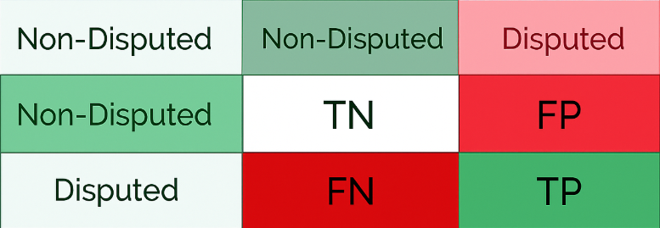
Confusion Matrix
Recall is more important if you want to minimize missed disputed tickets (i.e., reduce FN).
Precision is important to catch fewer wrongly flagged as disputed tickets (i.e. reduce FP).

Slide 15
Feature Importance
Vehicle State of Registration: influences 22% of dispute decisions — local vs. out-of-state drivers behave differently.
Issuer Precinct: accounts for 19.6%, reflecting variation in enforcement patterns and community responses.
Violation Location & Time: contribute 17.7% and 16.2%, indicating that where and when a ticket is issued impacts likelihood of dispute.
Vehicle Characteristics: (body type & make) jointly affect 24.4%, showing user type and brand behavior matter in disputes.

Slide 16
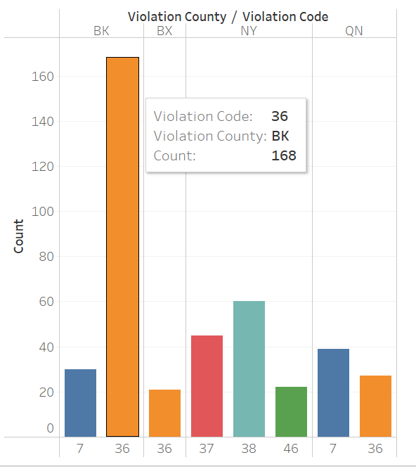
State | Violation County | Violation Code | Count
NY | BK | 36 | 168
NY | NY | 38 | 60
NY | NY | 37 | 45
NY | QN | 7 | 39
NY | BK | 7 | 30
NY | QN | 36 | 27
NY | NY | 46 | 22
NY | BX | 36 | 21

Slide 17
Challenges
Integrating indexers, vector assemblers, sampling logic, and hyperparameter tuning into a single pipeline was challenging to debug and optimize.
Using TrainValidationSplit or CrossValidator with large data can be computationally expensive without cluster optimization.

Slide 18
Conclusions
LinearSVC with Cross Validation is the best model for the NYC parking dataset due to its higher recall and balanced precision, effectively identifying disputed violations.
Considering model training efficiency, LinearSVC with Train Validation Split is preferred when quicker results are needed with minimal trade-off in performance.

Slide 19
References
New York City Open Data (2017)
Parking Violations Issued - Fiscal Year 2017.
Retrieved from: https://data.cityofnewyork.us/

Slide 20
Thank You

